Slide 1
The Role of Working Memory Capacity on the Effects of Positive/Negative Feedback on Memory Tasks
Andrew Snelling
Hanover College

Slide 2
Feedback
Feedback: (n.) the transmission of evaluative or corrective information about an action, event, or process
Merriam-Webster Dictionary

Slide 3
Feedback Effects
Study showing groups and individuals improve if given feedback when they fall under target goal
Matsui, T., etal.(1987)
Study presented that feedback enhances the positive effects and reduces the negative effects of multiple choice testing
Butler and Roediger (2008)
Notes:
Butler and Roediger are from Washington U in St.Louis, MR

Slide 4
Positive & Negative Feedback Effects
Negative Feedback’s Effects
The Negative feedback causes stress; Retroactive Interference
Negative feedback increases memory; Proactive Enhancement
Karten (2012)
Positive Feedback’s Effects
Study showed positive feedback increased intrinsic motivation for performing tasks
Harackiewicz (1979)

Slide 5
Feedback & Promotion/Prevention Tasks
Prevention Task
A task requiring vigilance and attention to detail
Arithmetic, Rote Memorization, etc.
Promotion Task
A task requiring creativity
Painting, Acting, etc.
Van Dijk (2011)
Study showing positive feedback increases performance in promotion tasks
Negative feedback increases performance in prevention tasks

Slide 6
Working Memory Capacity & Feedback
Working Memory Capacity (WMC)
The system that actively holds multiple pieces of transitory information in the mind, where they can be manipulated
Schmeichel & Demaree (2010)
Study showing Working Memory Capacity is an indicator of how well participants perceive themselves on a self-report given negative feedback of their emotional intelligence.

Slide 7
Research Question
In a prevention task, like a memory test, does positive or negative feedback increase performance, given Van Dijk says only negative feedback will?
Because WMC indicated the participants who performed less negatively after negative feedback, will it also indicate those who may perform better when given positive feedback?

Slide 8
Hypothesis
There will be a higher performance on the tasks for those given negative feedback than those given positive feedback.
Those with a higher WMC will be less susceptible to the effects of either positive or negative feedback.

Slide 9
Participants
Hanover College Students
Ages 18-22
N=34
Women=24, Men=10
Many Students that participated received extra credit for their Introductory Psychology class

Slide 10
Tasks
All tasks used White lettering, Font 24, on a Black background
Working Memory Capacity Task
Digit Span Test
Numbers Lasted 1 sec on Screen
Free-Recall Task
Using 30 common words
Words Lasted 3 sec on Screen
Grid shown containing 60 words
Notes:
Mention in talk: The time they had to perform recognition (30 sec), where I got the words from,

Slide 11
Procedure
Feedback
Randomly Assigning Feedback: given either Positive (Top 20%) or Negative (Bottom 40%)
Memory Span Test
First Free-Recall Test
Feedback Given
Second Free-Recall Test
Notes:
Mention in talk: the feedback was randomly assigned (evenly), the feedback was a proportion of how many of the original 30 words they got correct

Slide 12
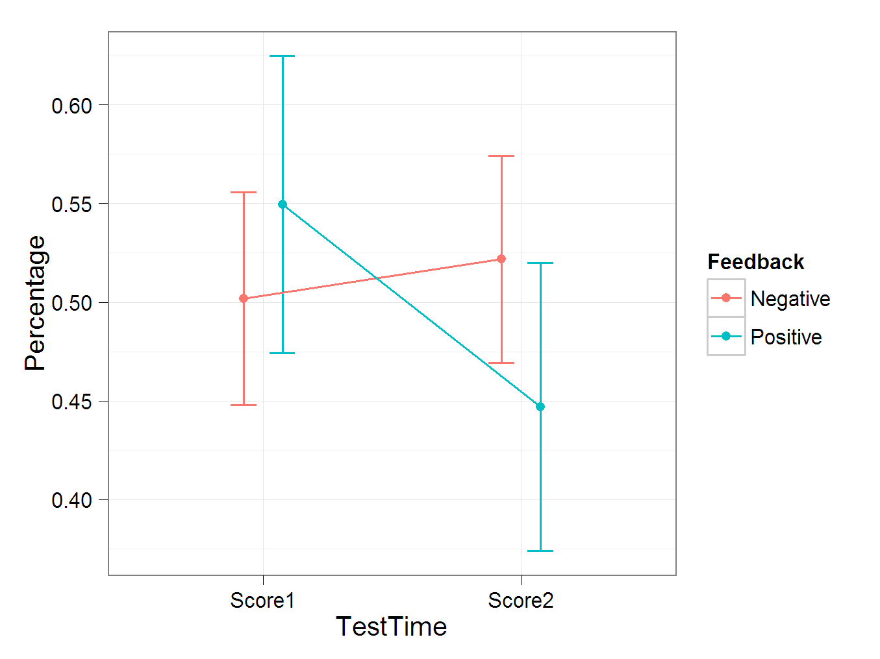
Results
Effect | Value
TestTime | F (1,32) = 4.33, p = 0.046
Feedback:TestTime | F (1,32) = 9.55, p = 0.004

Slide 13
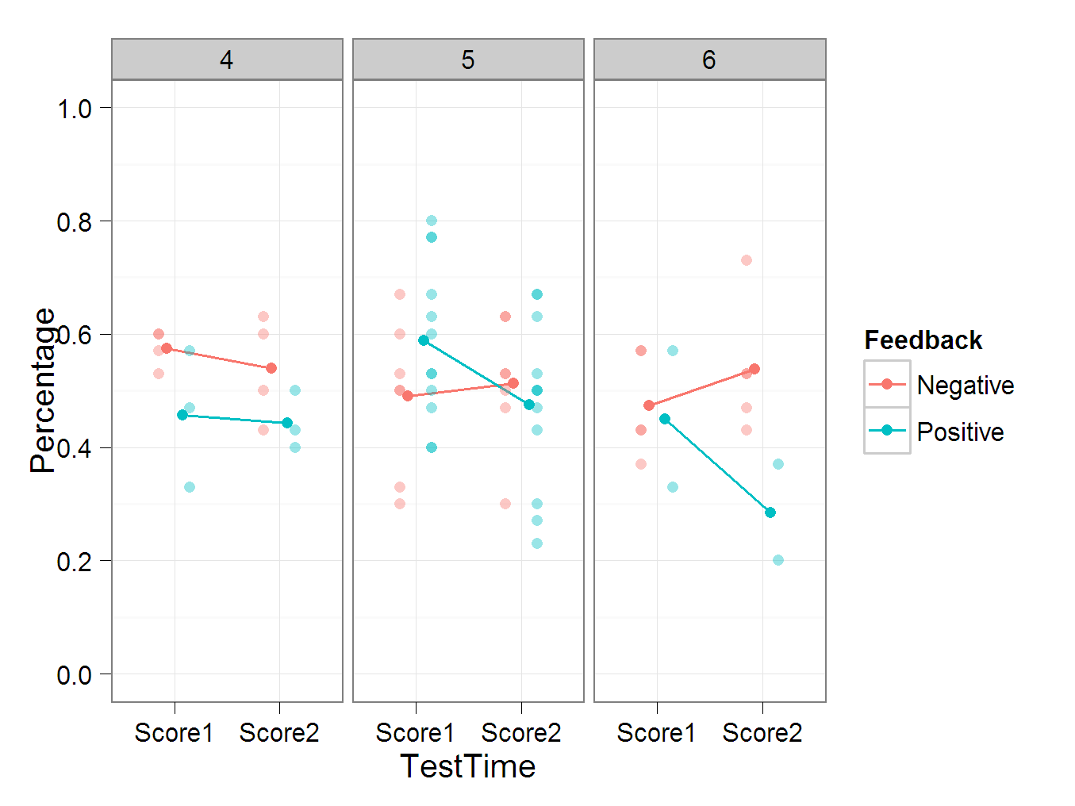
Results
N=7
N=19
N=8
Effect | Values
Feedback:WMC:TestTime | F (1,30) = 3.91, p = 0.057
Notes:
Add in how many people per WMC section: 4=7, 5=19, 6=8
This interaction has a p=0.0572

Slide 14
Discussion
There seems to be no significant effect of negative feedback increasing performance
There is a significant effect of positive feedback decreasing performance
There is a possible interaction between WMC, Feedback, and Test Time

Slide 15
Reasonings
Positive Feedback’s Effects
People do not try as hard
People’s memories are more relaxed
Negative Feedback’s Effects
People were not as surprised by results
Proactive Enhancement

Slide 16
Limitations / Future Research
Relatively Unvarying Working Memory Capacity Across Participants
Using Positive and Negative Feedback on Promotion Tasks
Having an Authority Figure Issue the Feedback

Slide 17
Questions

